Slide 1

TYPING TUTOR IN C SOFTWARE DESIGN SPECIFICATIONS
Guide: Dr. Krishnapriya
Group:
Athul Babu K (NIE22CS019)
Sobin Seby (NIE22CS047)
Sojo Jenson (NIE22CS048)

Slide 2
OBJECTIVES
To present the design considerations and system architecture of the typing tutor software.
To explain the development methods and tools used in the project.
To showcase the user interface design and system components.
To highlight the key features and functionalities of the application.

Slide 3
ABSTRACT OF THE PROJECT
What is CMD TypeSwift?
A terminal-based typing tutor for programmers.
Helps improve typing speed and accuracy while learning programming concepts.
Key Features:
Real-time feedback, error tracking, speed analysis, and ability to lessons.
Target Audience:
Programmers and anyone learning computer science who prefer command-line interfaces.

Slide 4
PROPOSED TOOLS AND SELECTION RATIONALE
Tools:
GCC Compiler: For compiling C code.
Git: For collaboration and version control.
GNOME Terminal, xterm, uxterm: For terminal compatibility.
Bash Scripting: For installation and uninstallation scripts.
Selection Rationale:
GCC: Robust and widely supported.
Git: Industry standard for version control and collaboration.
Terminal Emulators: Widespread adoption among programmers.
Bash: For simple and effective scripting.

Slide 5
SYSTEM OVERVIEW
Functionality:
Typing lessons with real-time feedback.
Speed tracking (CPM and WPM).
Error tracking and session results.
Ability to add custom lessons via ‘myown.txt’.
Design Considerations:
Lightweight and efficient.
Terminal-based for Unix-like systems.
Focus on user feedback and customization.

Slide 6
DESIGN CONSIDERATIONS
Assumptions and Dependencies:
Unix-like OS(Linux, macOS)
Compatible terminal emulator (GNOME Terminal, xterm, uxterm).
GCC Compiler for C code.
General Constraints:
Minimal hardware requirements.
Unix-like environment and command-line familiarity.

Slide 7
DEVELOPMENT METHODS
Modular Programming:
Application divided into modules (UI, lesson manager, error tracker, etc.).
Test-Driven Development (TDD):
Unit tests for each module to ensure reliability.

Slide 8
SYSTEM ARCHITECTURE
High-Level Overview:
User Interface (UI): Handles user interaction and feedback.
Lesson Manager: Manages lesson loading and selection.
Error Tracker: Tracks error in real-time.
Speed Analyzer: Calculates typing speed.
Sesson Logger: Records session details to be displayed later.
Component Interaction:
UI interacts with lesson manager, error tracker, and speed analyzer.
Session logger records details during each session.

Slide 9
DETAILED SYSTEM DESIGN
User Interface (UI):
Terminal-based with colour-coded feedback.
Commands like cmd typswt –help and cmd typswt mkuser.
Lesson Manager:
Loads lessons from predefined or user-defined files.
Error Tracker:
Monitors and logs errors in real-time.
Speed Analyzer:
Calculated Characters Per Minute (CPM) and Words Per Minute (WPM).
Session Logger:
Records session details

Slide 10
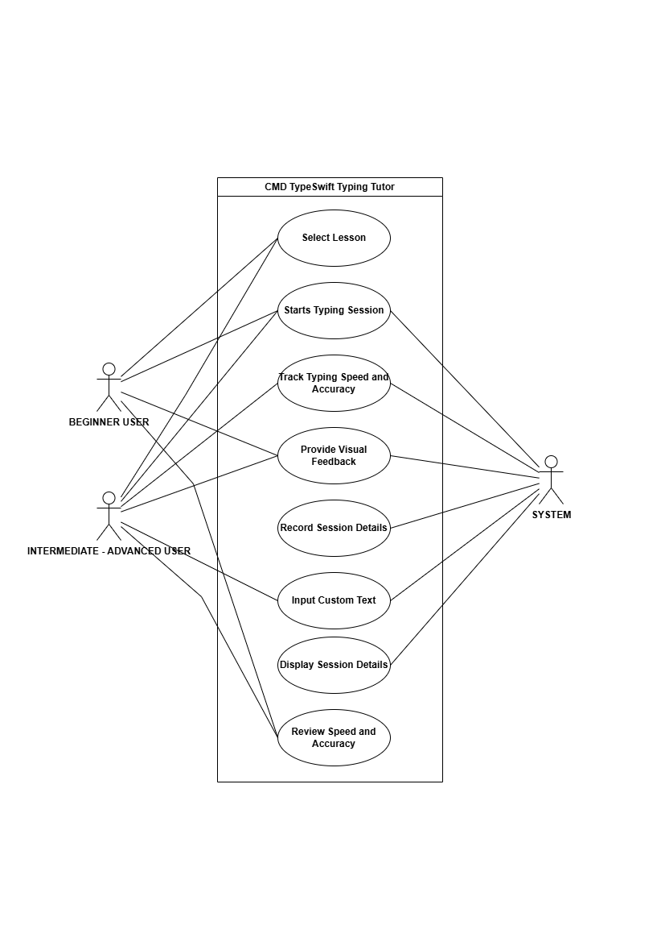
UML DIAGRAMS: Use Case Diagram

Slide 11
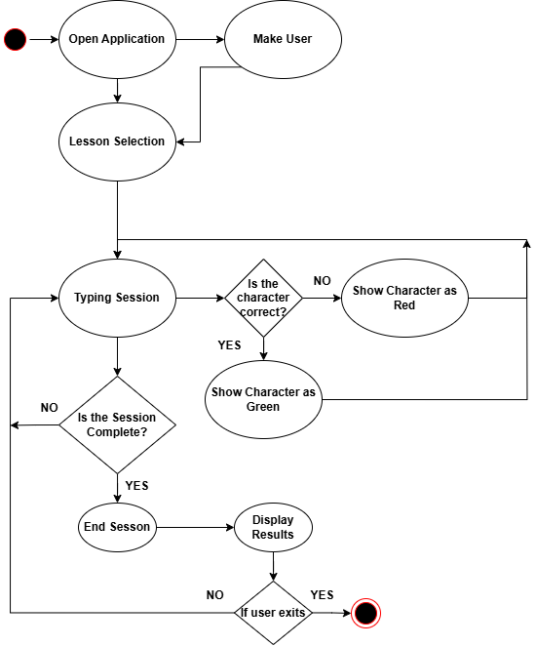
UML DIAGRAMS: Activity Diagram

Slide 12
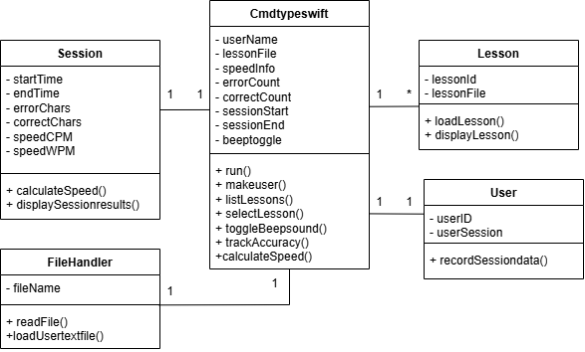
UML DIAGRAMS: Class Diagram

Slide 13
INTERFACES (UI) AND USER ROLES
User Interface Screens:
Main menu: Displays available commands and options.
Lesson Selection: Allows users to select a lesson.
Typing Session: Displays lesson text with real-time feedback.
Session Summary: Shows errors, speed, and time.
User Roles:
New Users: Can start with basic lessons.
Experienced Users: Can add custom lessons.
Administrators: Can manage lesson files and system settings.

Slide 14
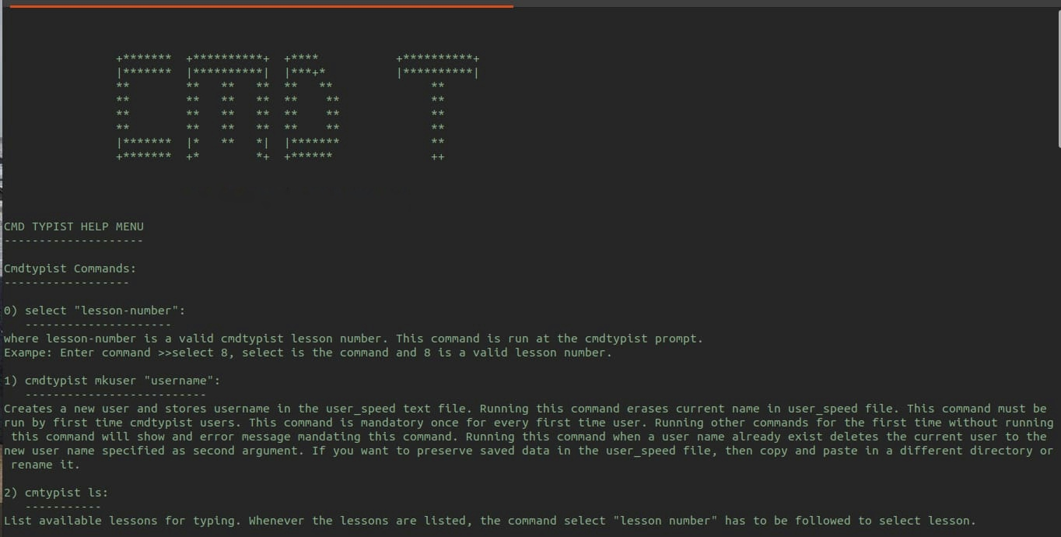
UI MODELS

Slide 15
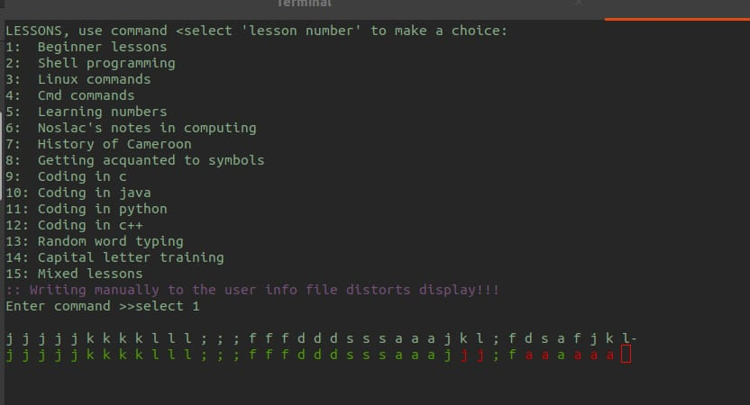
UI MODELS

Slide 16
CONCLUSION
Recap of Objectives:
Presented the design considerations and system architecture.
Explained the development methods and tools used.
Showcased the user interface design and system components.
Highlighted the key features and functionalities.

Slide 17
THANK YOU

